Slide 1

Advanced Heat Pump Water Heater Research Update
Conducted by WSU Energy Program
Funded by Bonneville Power Administration
BPA Technology Innovation Projects 292, 302 and 326

Slide 2
Current Status
Pacific Northwest CO₂ HPWH Research
Lab test of Sanden French manufactured unitary 40 gallon HPWH sponsored by NEEA
Lab test of Sanden Australian manufactured split 84 gallon HPWH sponsored by BPA
Field test of split system at 4 sites
Demand Response assessment of Sanden unitary and split systems currently underway sponsored by BPA
Field test for combined space and water heat in Next Step Homes sponsored by NEEA and BPA and lab test sponsored by BPA

Slide 3
Project Teams
(For All Projects)
WSU
Ken Eklund, Principal Investigator and General Project Manager
David Hales, Field Monitoring Installation and Maintenance
Adria Banks, Data Analyst
Lab Tests
Ben Larson, Ecotope, Test Manager and Analyst
Kumar Banerjee, Cascade Engineering, Lab Test Director
Field Installations
Mark Jerome, Clear Result, System Installation Coordinator
BPA
Janice Peterson, Project Manager
Stephanie Vasquez, Project Technical Representative
Sanden
Maho Ito, CO₂ Product Line Manager
Charles Yao, Project Engineer

Slide 4
Project Teams Continued
Demand Response Controlled Field Study (TIP 302)
    Graham Parker, PNNL – Lab Homes Project Lead
    Joe Petersen, PNNL – Technical Lead
    Greg Sullivan, Efficiency Solutions – Technical Consultant
    Austin Winkelman, PNNL – Engineering Intern
    Tony Koch, BPA – Demand Response Engineer
    Frank Brown, BPA – Demand Response and Efficiency
    Thor Hinckley, BPA – Smart Grid and Demand Response
  Combi System Research
      Charlie Stephen, NEEA – Project Manager
      Thomas Anreise and Dan Wildenhaus, Clear Result –
      Next Step Home site analysis and recruitment

Slide 5
TIP 292 Project Overview
Performance test of split system CO₂ refrigerant Heat Pump Water Heater manufactured by Sanden
Lab test to DOE and Northern Climate Specification
Field test in partnership with NEEA and:
Avista Heating Zone 2
Energy Trust of Oregon Heating Zone 1
Ravalli Electric Coop Heating Zone 3
Tacoma Power Heating Zone 1
One install in each territory. 12-18 month monitoring.

Slide 6
TIP 302 Project Overview
Demand Response tests of Sanden unitary and split system Heat Pump Water Heater
Controlled Field Study at PNNL Lab Homes in Richland, WA – Currently underway
Demand Response Lab tests at Cascade Engineering Services in Redmond, WA – Protocol under development by Ben Larson

Slide 7
Combi System Research
WSU, NEEA and BPA are engaged in research in the use of the Sanden split system unit for combination space and water heating in highly efficient Next Step Homes
The partners are currently recruiting builders and sites through the Next Step Home project
NEEA will provide all the monitoring plus incentives
BPA has agreed to fund the lab test and analysis and reporting of data from both the field and lab research

Slide 8
Quick Specifications
Equipment currently built and sold in Australia
Outdoor Unit Model: GAU-A45HPA
Power Input: 240V, 15 A circuit
Tank Model: GAU-315EQTA
Storage Capacity: 315L (83 gallons)
Tank Set Point: 65°C (149°F) – not adjustable
Outdoor unit has a variable speed inverter driven compressor, fan and pump
Water is heated at the outdoor unit. A pump circulates water from the bottom of the tank, to the outdoor unit heat exchanger, heating the water in one pass, and re-injecting the hot water near the top of the tank
No resistance heating element

Slide 9
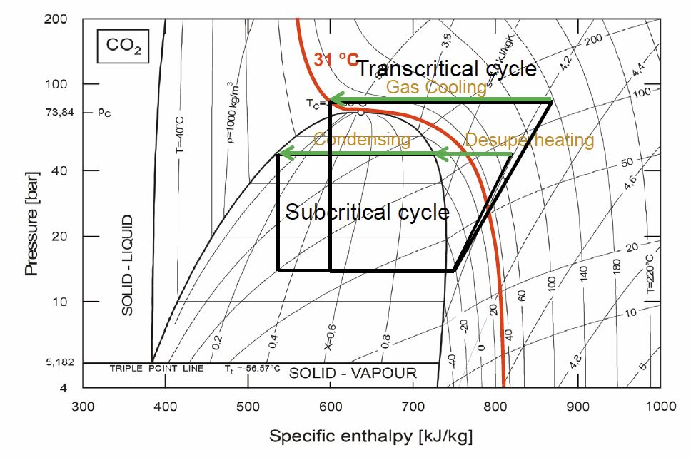
CO₂ Refrigerant Function
Source: Rolf Christensen, ATMOsphere 2014

Slide 10
Performance vs. Temperature
Outside Air Temperature (F) | Energy Factor (EF) | COP | Output Capacity (kW) | Input Power (kW)
17 | 1.74 | 2.1 | 4.0 | 1.9
35 | 2.21 | 2.75 | 3.6 | 1.3
50 | 3.11 | 3.7 | 4.0 | 1.1
67 | 3.35 | 4.2 | 4.1 | 0.97
95 | 4.3 | 5.0 | 4.6 | 0.93
Linear fit of EF to temperature
Use TMY temperature bins to calculate an annual EF:
Climate | Annual EF
Boise | 2.9
Kalispell | 2.6
Portland | 3.0
Seattle | 2.9
Spokane | 2.8

Slide 11
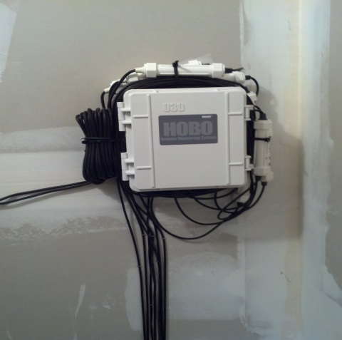
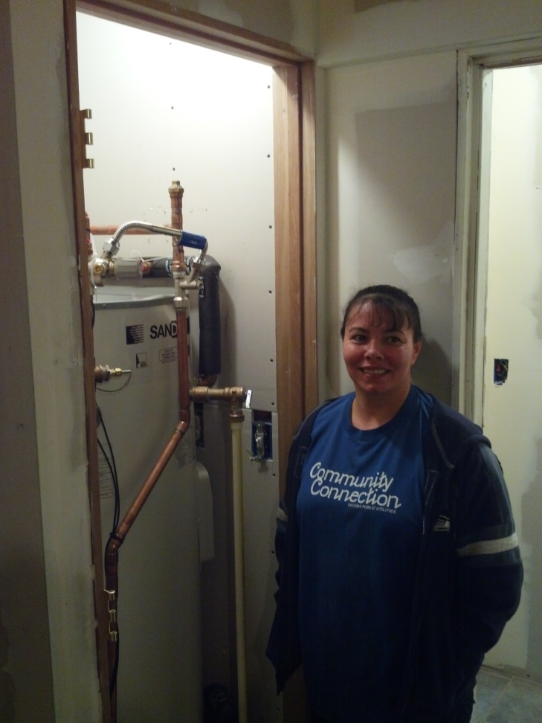
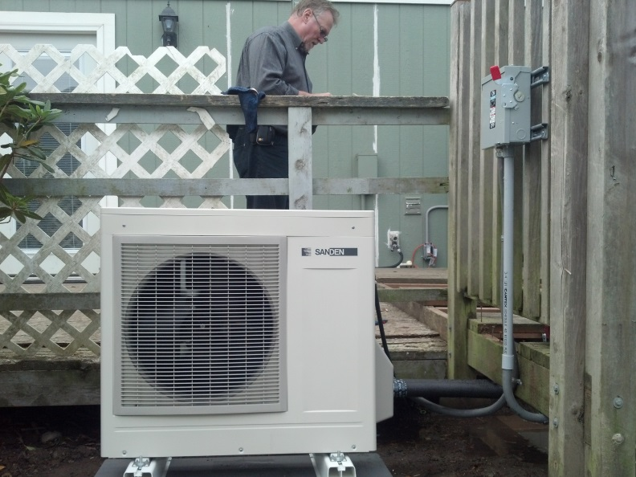
Installation-Tacoma-10-15-13

Slide 12
TIP 292 Field Site Characteristics
Site Location | Site HDD | Climate Area
Portland, OR | 4,461 | Western Oregon
Tacoma, WA | 4,696 | Puget Sound
Addy, WA | 6,842 | Inland Washington
Above Corvallis, MT | 8,156 | Mountain Region
Each site has at least 4 occupants
At least 3 years of electric hot water use
Represents a climate within the Pacific Northwest

Slide 13
Climate Data
From Installation through March 31, 2014
Site | Minimum OAT (F) | Mean OAT (F) | Standard Deviation (F)
Portland | 17.89 | 44.23 | ± 8.88
Tacoma | 22.20 | 43.35 | ± 5.33
Addy | 2.08 | 34.17 | ± 8.64
Montana | -15.68 | 32.96 | ± 11.74

Slide 14
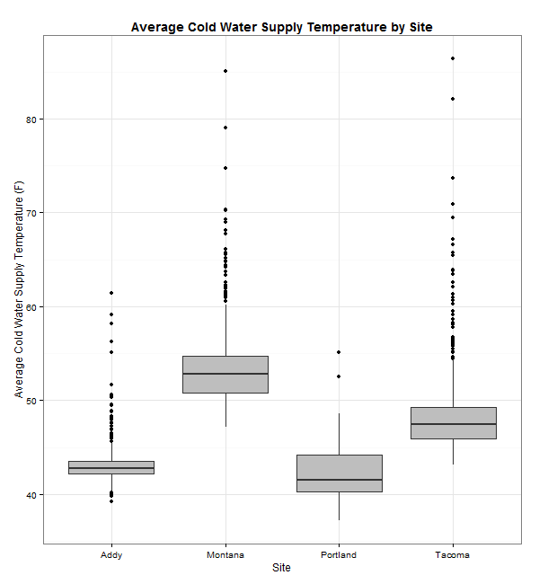
Average Cold Water Temp

Slide 15
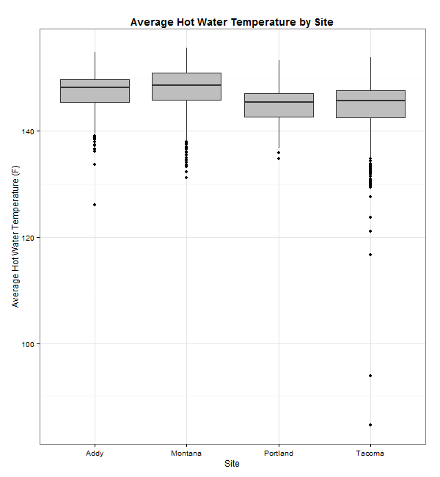
Average Hot Water Supply Temp

Slide 16
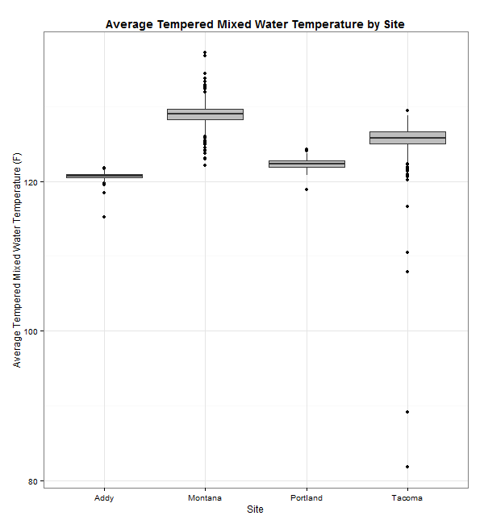
Average Tempered Water Temp

Slide 17
Water Use Per Site
Site | Total Cold Water Supply Water (Gal/day) | Calculated Total Water added to Tempering Valve (Gal/day) | Total Household Hot Water (Gal/day)
Addy | 77.6 | 26.5 | 104.0
Montana | 50.5 | 12.4 | 62.6
Portland | 44.0 | 12.2 | 55.9
Tacoma | 64.7 | 15.8 | 79.5

Slide 18
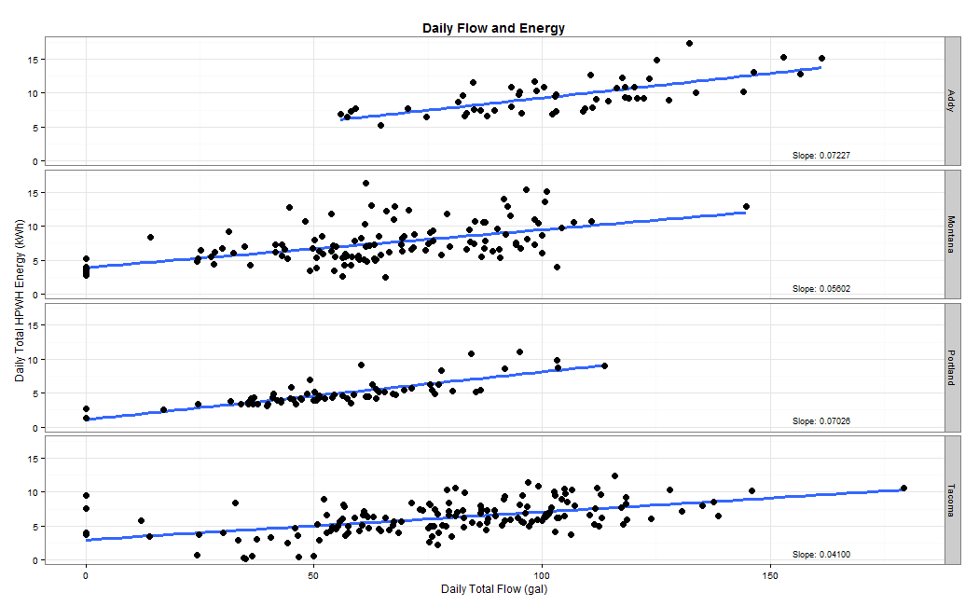
Daily Water Flow and Energy

Slide 19
Field Energy Factor
Is the Energy Contained in Total Useful Hot Water / Total Energy In
Contains all the invested energy including compressor and freeze protection
Also includes the energy losses from the tank and the piping
Plus variable such as the ground water temperature—which varied significantly

Slide 20
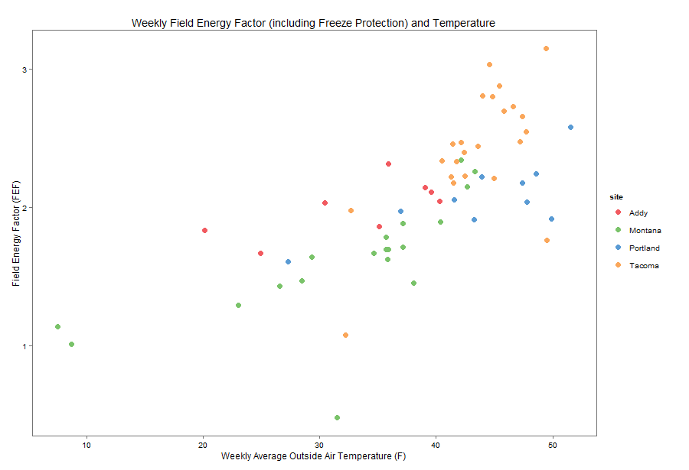
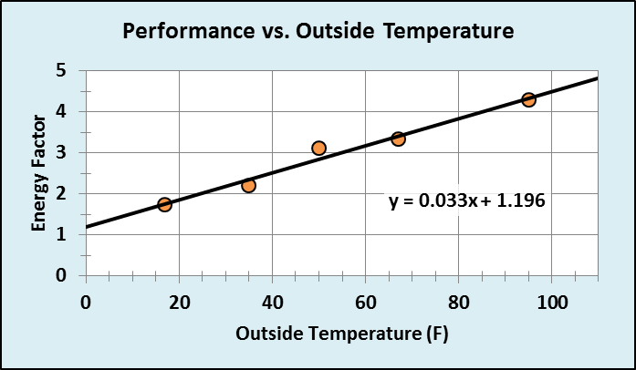
Field Energy Factor & Outside Air Temp.

Slide 21
Interim Conclusions
From Installation Through March 31, 2014
The largest performance factors appear to be amount of daily water use and outside air temperature
The Sanden system is capable of providing 150ºF water in minus zero weather and can operate to minus 15.7ºF
The weekly Field Energy Factors ranged from 1.1 during a week averaging below 10ºF OAT to 2.5 at 40ºF OAT

Slide 22
Next Steps
Performance Research
Second Interim Report
  Data from April 1 through July 31, 2014
  Report due September 30, 2014
Final Analysis and Report
  Data through February, 2015
  Report due summer, 2015
Demand Response Research
Complete PNNL study, analyze and report
Finalize lab protocol, conduct test, analyze and report
Combi System Research
Recruit, qualify, install systems and monitoring at NSH sites
Collect data for at least one year, analyze and report

